Slide 1

WAY TO ENTERPRISE
React JS
VTI ACADEMY
Author: duy.nguyenngoc1@vti.com.vn
March 2020

Slide 2
Agenda
Redux-thunk
Redux DevTools
Redux Toolkit
Assignments
Copyright © VTI Academy All Rights Reserved

Slide 3
Middleware
Is an intermediate layer between Reducer and dispatch Action
Example: write log, condition checking
Handle asynchronous actions and side effects
Types
redux-thunk
redux-saga
redux-promise
redux-observable

Slide 4
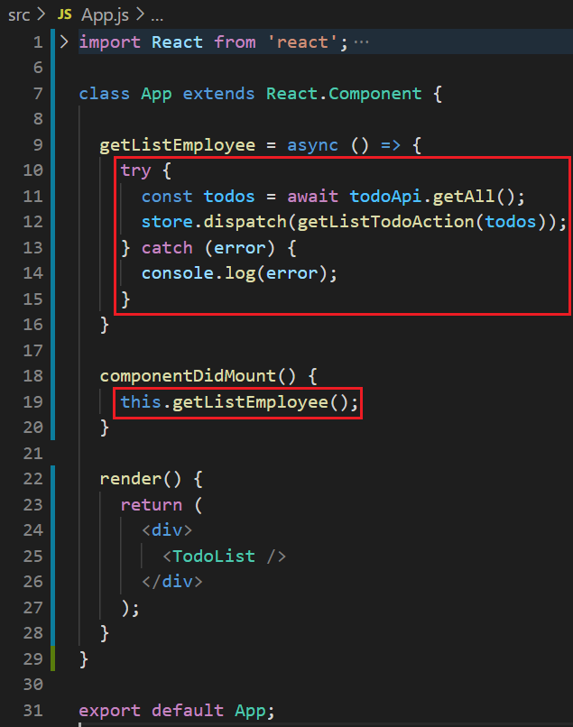
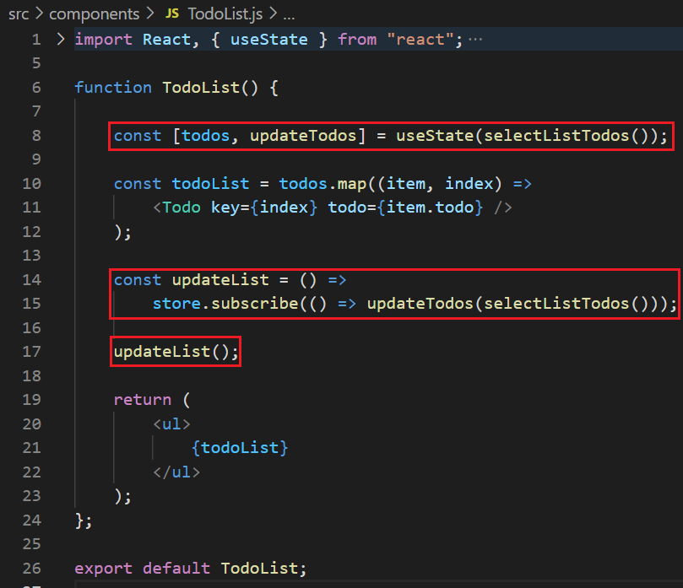
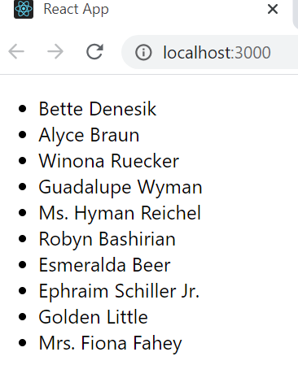
Redux-thunk
Example 1:
Logic in Component

Slide 5
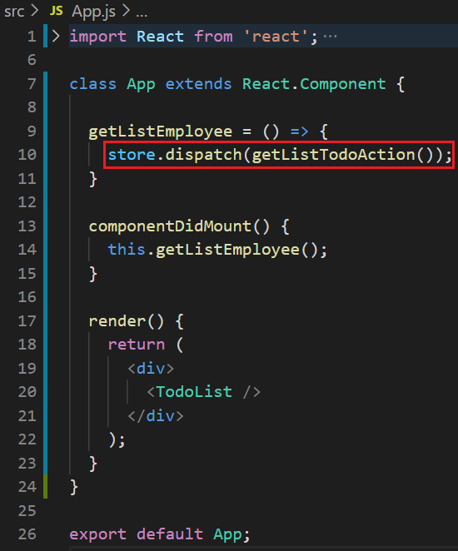
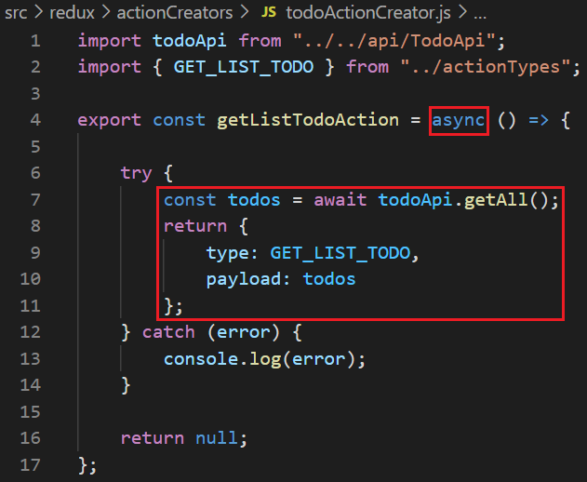
Redux-thunk
Example 2: dispatch async action
Logic in async action object

Slide 6
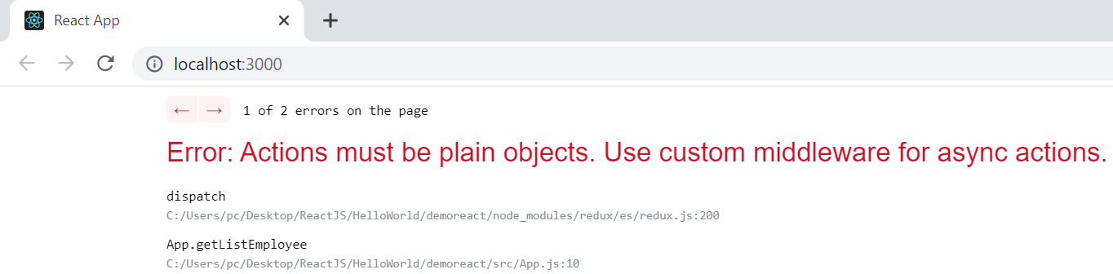
Redux-thunk
The action can only be a sync function, not an async function
(could not dispatch 1 async action)
➔ Fix with redux-thunk

Slide 7
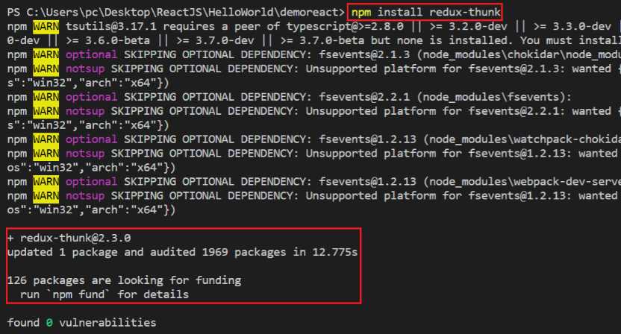
Redux-thunk
Fix with redux-thunk
npm install redux-thunk

Slide 8
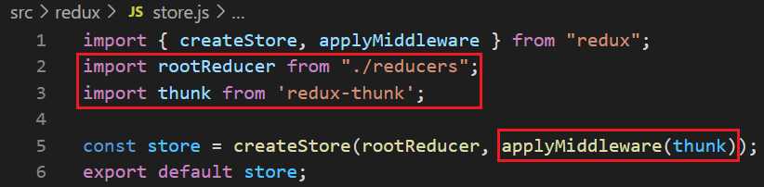
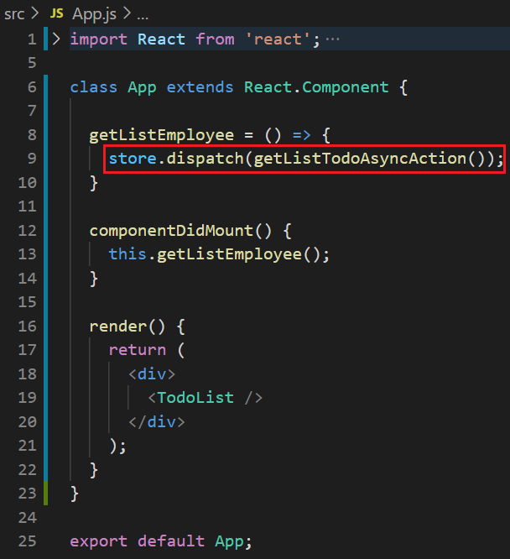
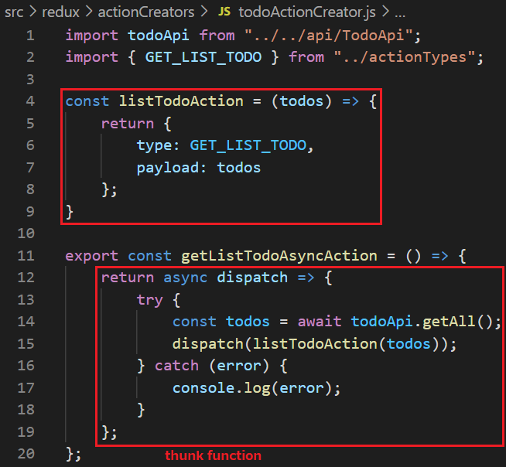
Redux-thunk
Fix with redux-thunk
Redux-thunk

Slide 9
Testing System Assignment
Self-practice

Slide 10
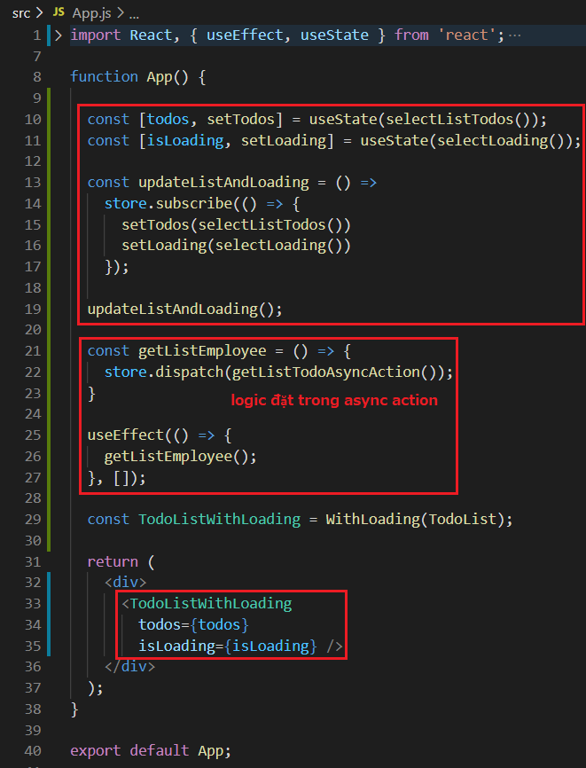
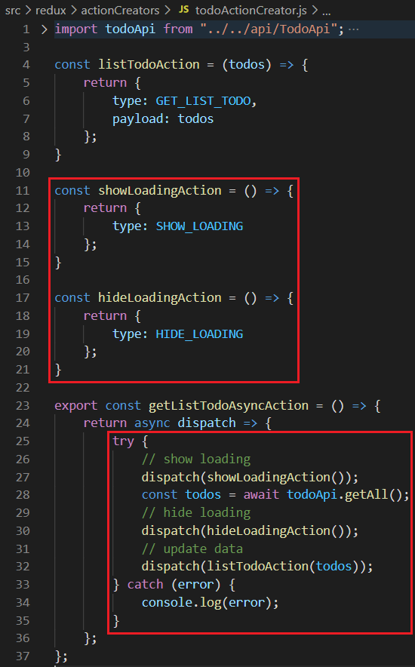
Redux-thunk
Example 3: call api with loading hoc

Slide 11
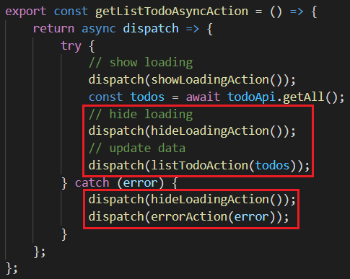
Redux-thunk
Example 4: Dispatch Todos or Error Action

Slide 12
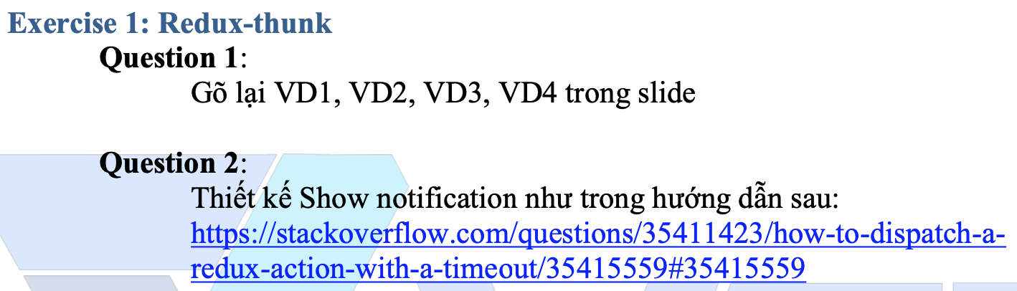
Testing System Assignments
Exercise 1: Redux-thunk – Question 2

Slide 13
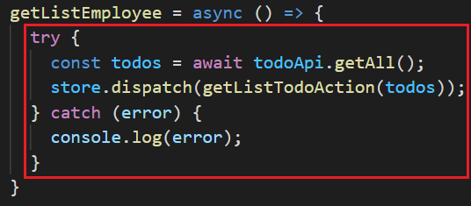
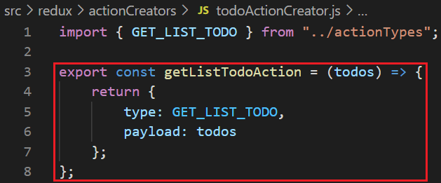
Summary
Allow dispatch async action (side effect)
Sync action
Async action

Slide 14
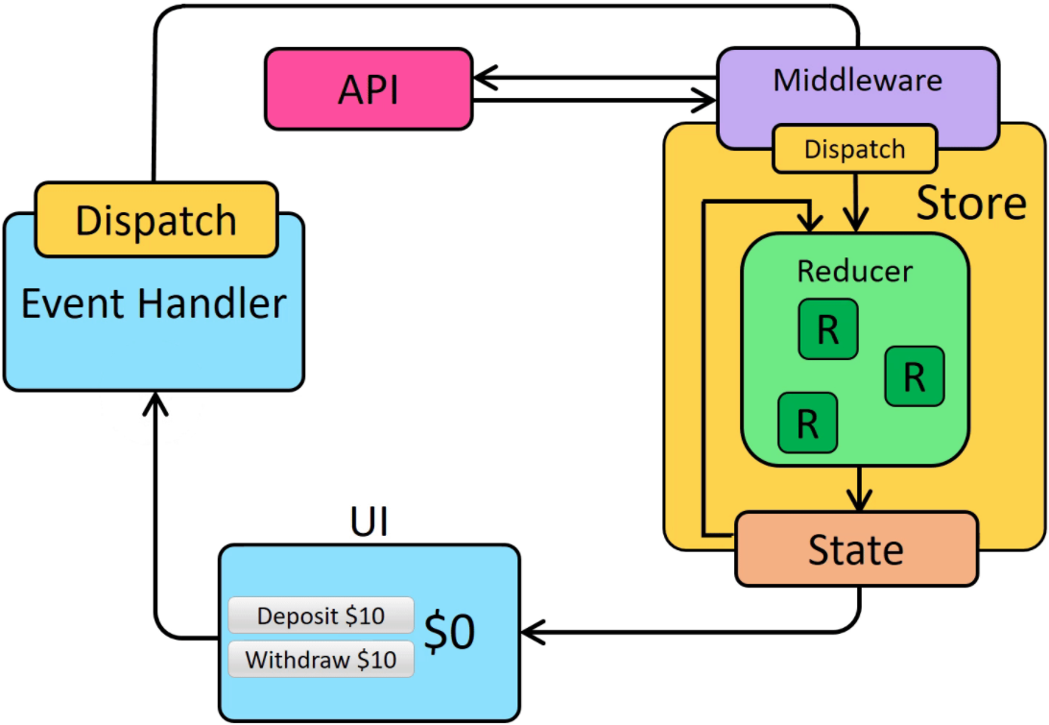
Summary
Flow
https://redux.js.org/assets/images/ReduxAsyncDataFlowDiagram-d97ff38a0f4da0f327163170ccc13e80.gif

Slide 15
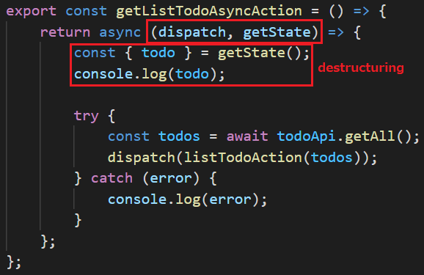
Summary
Thunk is a currying function
params
dispatch (function)
getState (function)

Slide 16
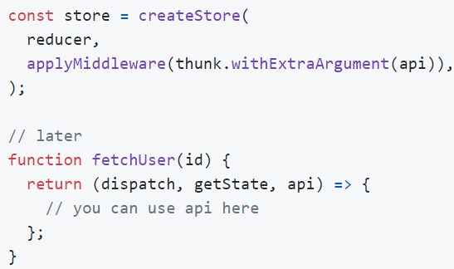
Redux-thunk
withExtraArgument
https://github.com/reduxjs/redux-thunk#injecting-a-custom-argument

Slide 17
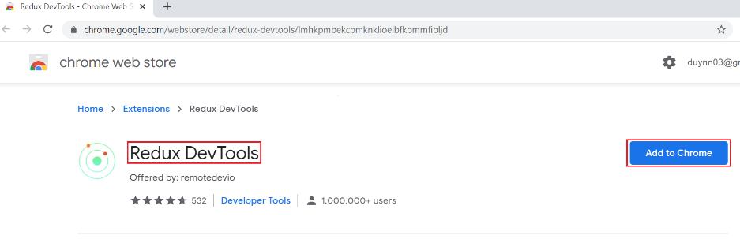
Redux DevTools
An extension allows you to check the information of redux
Add extension
https://chrome.google.com/webstore/detail/redux-devtools/lmhkpmbekcpmknklioeibfkpmmfibljd?hl=en
Home Page: https://github.com/zalmoxisus/redux-devtools-extension/

Slide 18
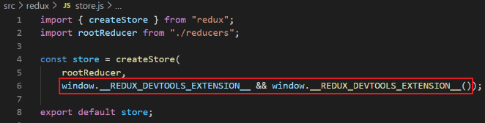
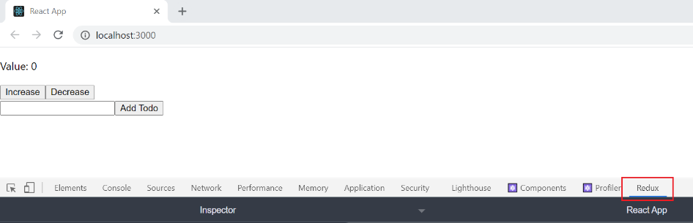
Redux DevTools
Setup project
window.__REDUX_DEVTOOLS_EXTENSION__ && window.__REDUX_DEVTOOLS_EXTENSION__({ trace: true })
Open redux DevTools

Slide 19
Redux DevTools
Other setup
https://github.com/zalmoxisus/redux-devtools-extension/blob/master/README.md#13-use-redux-devtools-extension-package-from-npm

Slide 20
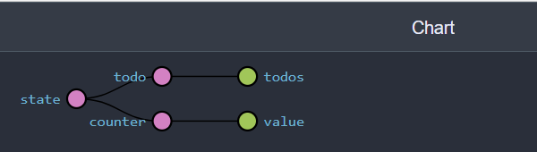
Redux DevTools
Features
chart
View store structure

Slide 21
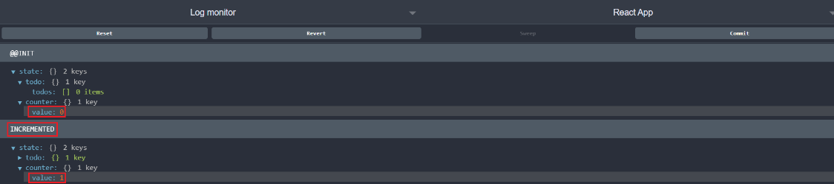
Redux DevTools
Features
log monitor
View state structure

Slide 22
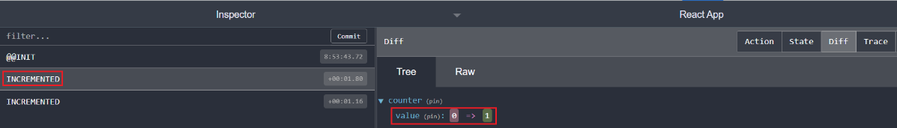
Redux DevTools
Features
inspector
View state, action

Slide 23
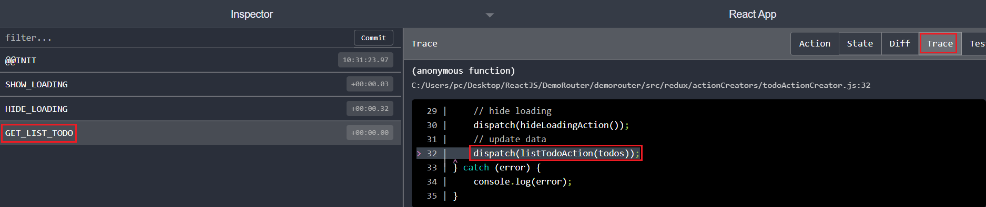
Redux DevTools
Features
Trace
View where the action was taken

Slide 24
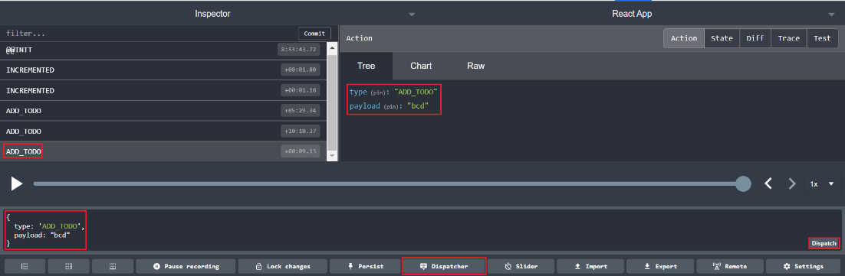
Redux DevTools
Features
Dispatch action

Slide 25
Redux DevTools
Features
play
Lets you review the action performed on the page

Slide 26
Testing System Assignment
Self-practice

Slide 27
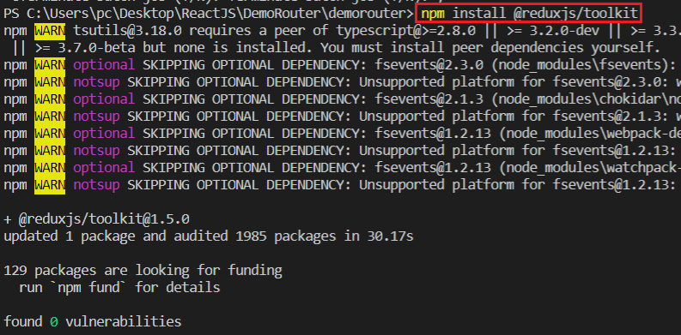
Redux Toolkit
Integrated Redux Core, Redux DevTools, Redux-thunk
Avoid creating too many packages similar to Redux core
Install
npm install @reduxjs/toolkit

Slide 28
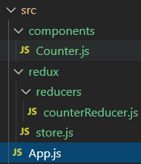
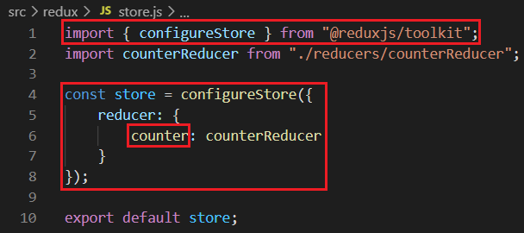
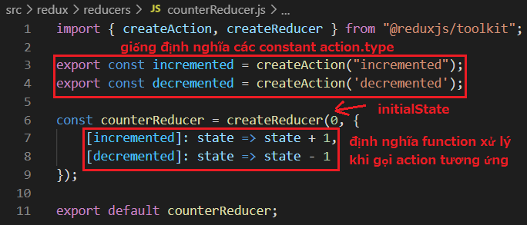
Redux Toolkit
Example 1: CreateReducer & CreateAction
Structure
Store
Reducers

Slide 29
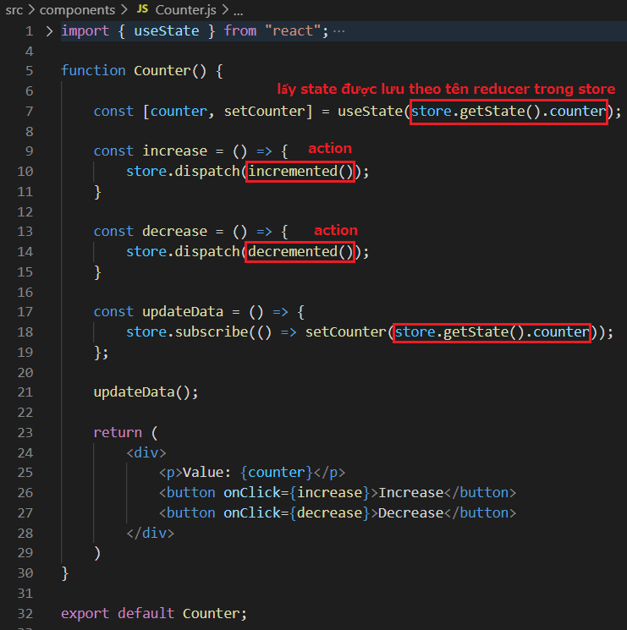
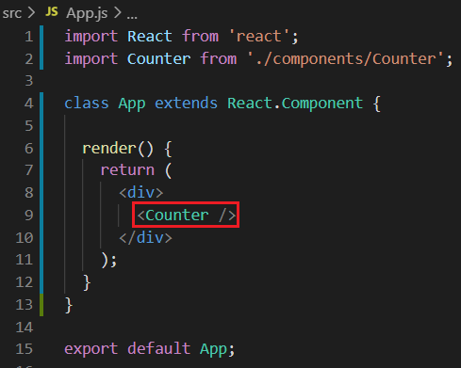
Redux Toolkit
Using

Slide 30
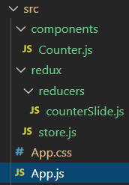
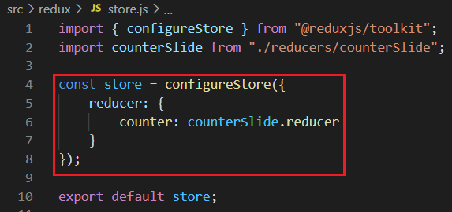
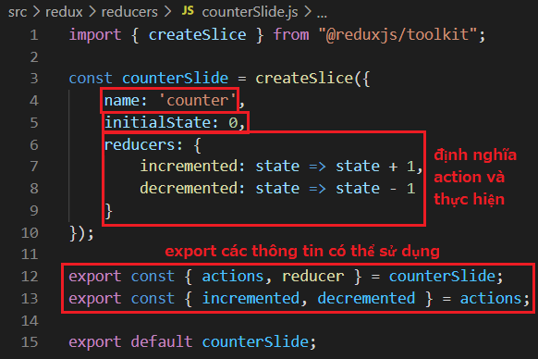
Redux Toolkit
Example 2: CreateSlide
Structure
Store
Reducers

Slide 31
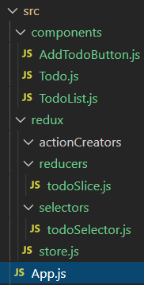
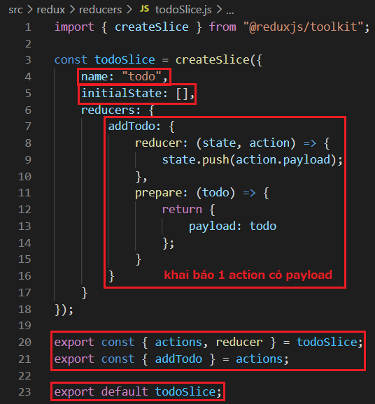
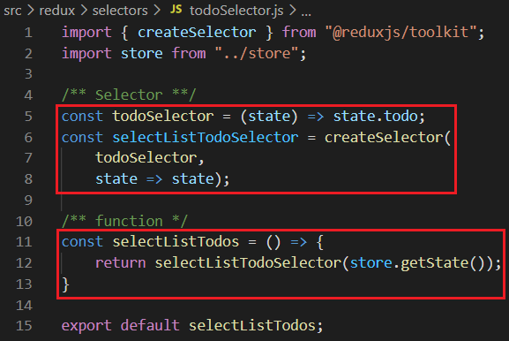
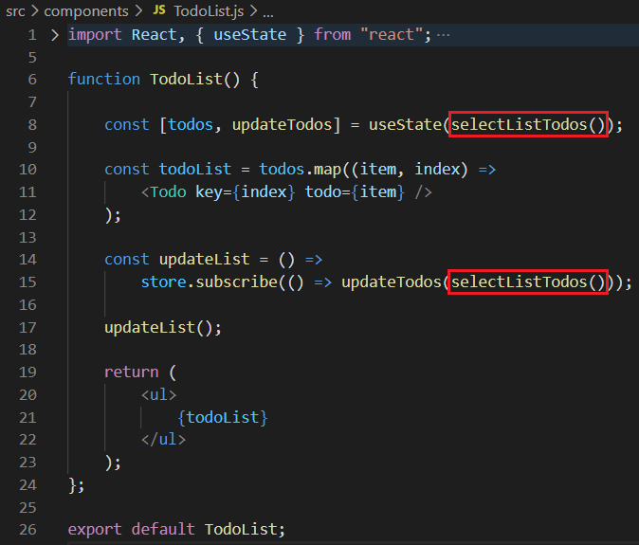
Redux Toolkit
Example 3: CreateSelector
Selector
Structure
Reducers
Using

Slide 32
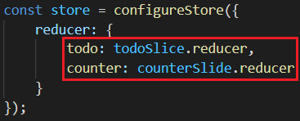
Redux Toolkit
Example 4: multiple reducer
No need for Root Reducer

Slide 33
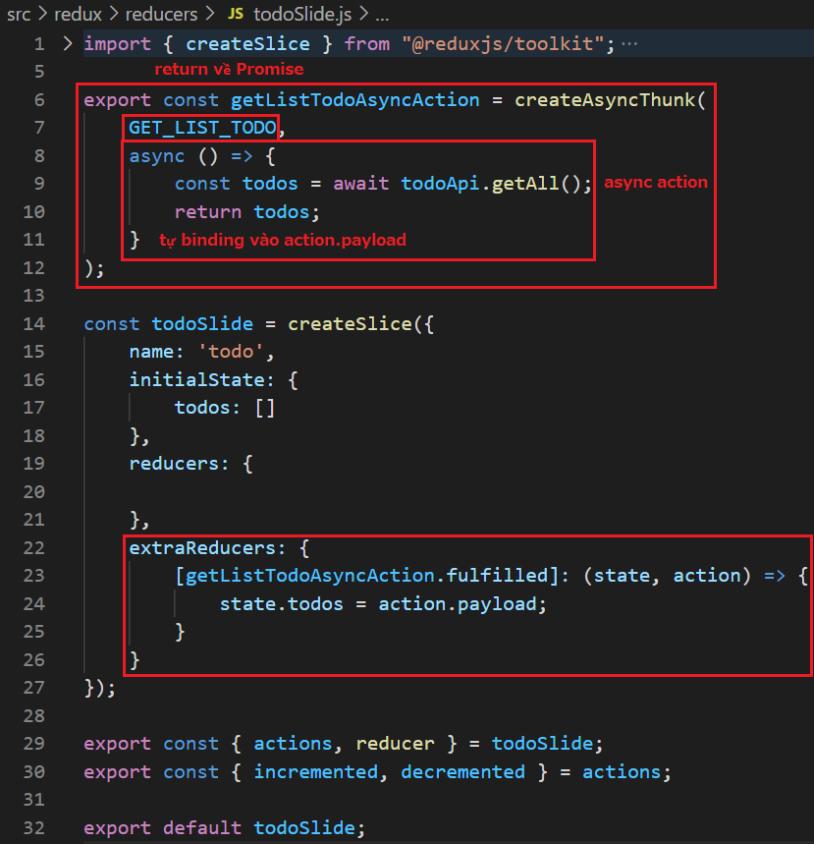
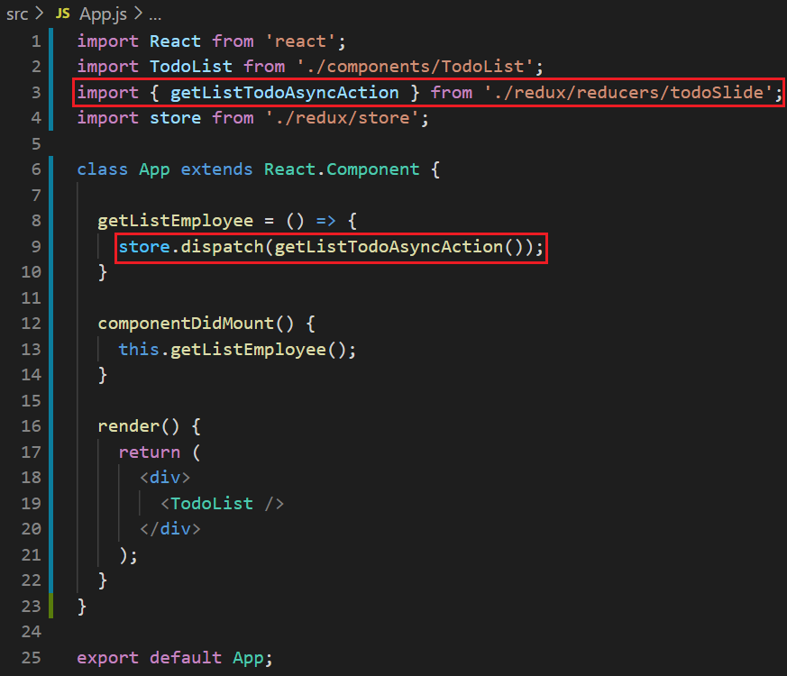
Redux Toolkit
Example 5: createAsyncThunk
Using
Slide & Thunk

Slide 34
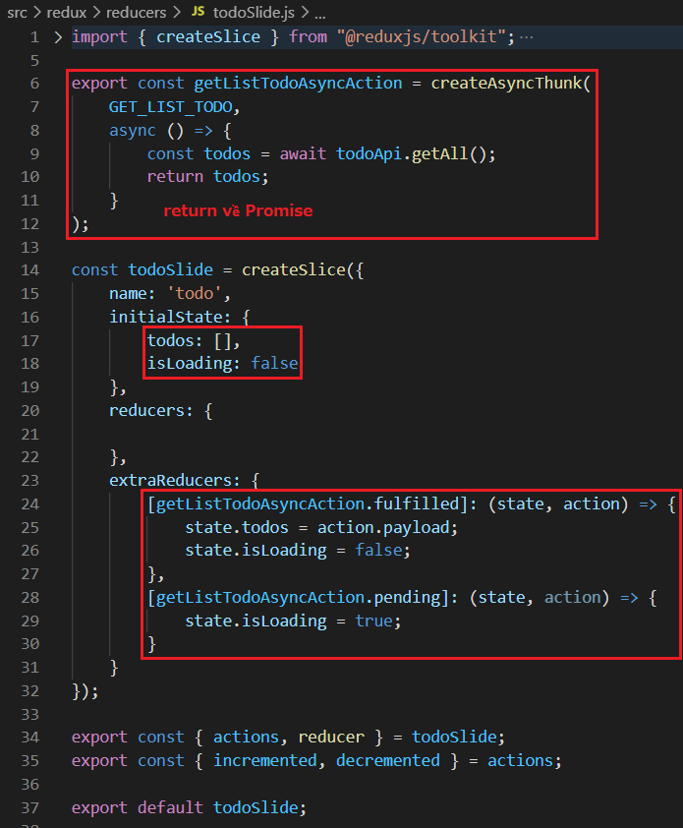
Redux Toolkit
Example 6: createAsyncThunk & loading

Slide 35
Testing System Assignment
Self-practice

Slide 36
Summary
configureStore()
No need for root reducers
Integrated Redux DevTools, Redux-thunk

Slide 37
Summary
createAction() & createReducer()
It take state and action as params
Edit state directly (no need to clone to new state object)

Slide 38
Summary
createSlice()
Actions only have type attribute
Action has payload
Async action

Slide 39
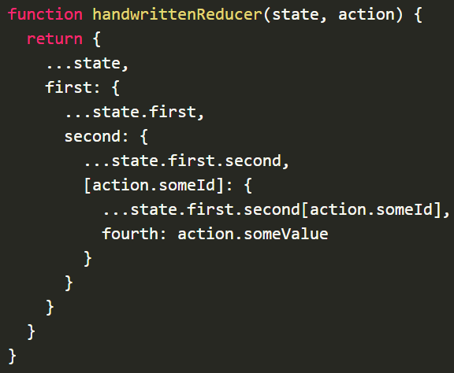
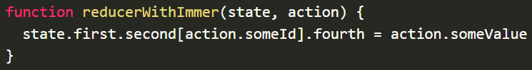
Summary
createSlice()
Edit state directly

Slide 40
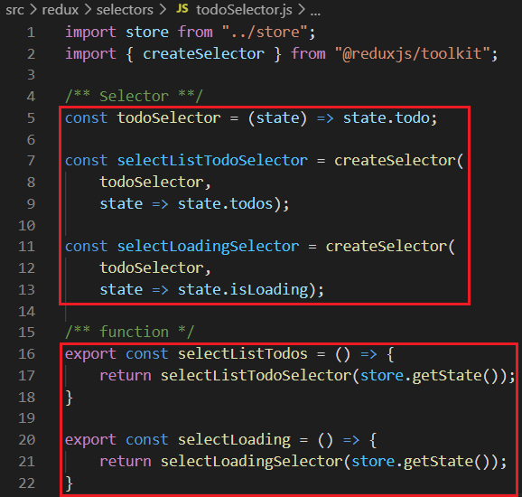
Summary
createSelector()
Use library: https://github.com/reduxjs/reselect to optimize re-render at the component

Slide 41
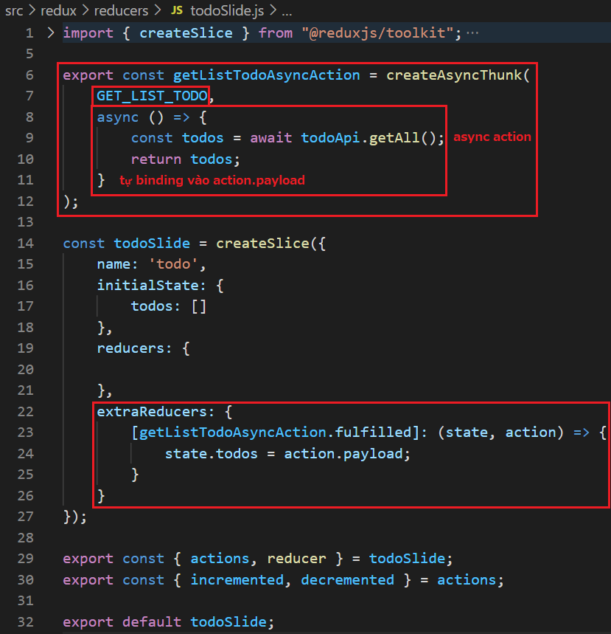
Summary
createAsyncThunk()

Slide 42
Summary
API
configureStore()
createAction() & createReducer()
createSlice()
createSelector()
createAsyncThunk()

Slide 43
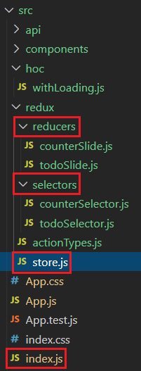
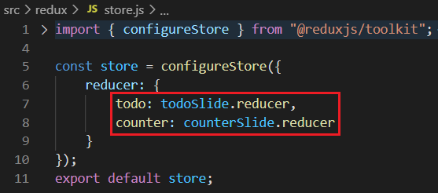

Redux Core + React Redux + Redux Toolkit Template
Store
Structure

Slide 44


React Redux + Redux Toolkit Template
Slide

Slide 45


React Redux + Redux Toolkit Template
Selector

Slide 46


React Redux + Redux Toolkit Template
Component

Slide 47

React Redux + Redux Toolkit Template

Slide 48
Testing System Assignment
Self-practice

Slide 49

Testing System Assignments

Slide 50
Reference
https://reactjs.org/docs/getting-started.html
https://www.javatpoint.com/reactjs-tutorial
https://www.udemy.com/course/react-the-complete-guide-incl-redux

Slide 51
Q & A
Copyright © VTI Academy All Rights Reserved

